Slide 1

Insights from 30 Days of #LinkedInHardMode
David M Vermillion

Slide 2
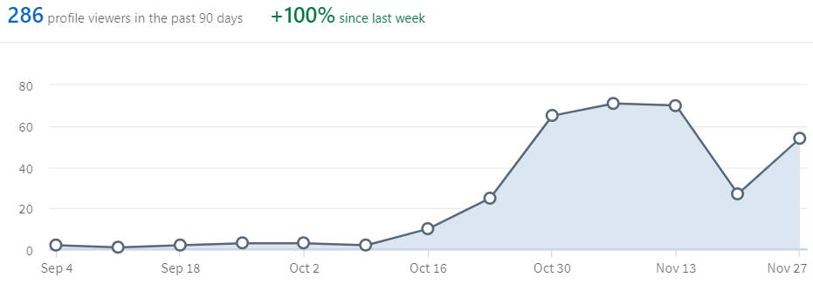
Challenge Gains
3,000% more median weekly profile views since starting challenge
153 new connections

Slide 3
Median Post Performance
 | Views | Interactions | Comments
Baseline | 87 | 2 | 2
Challenge | 557 | 10 | 8

Slide 4
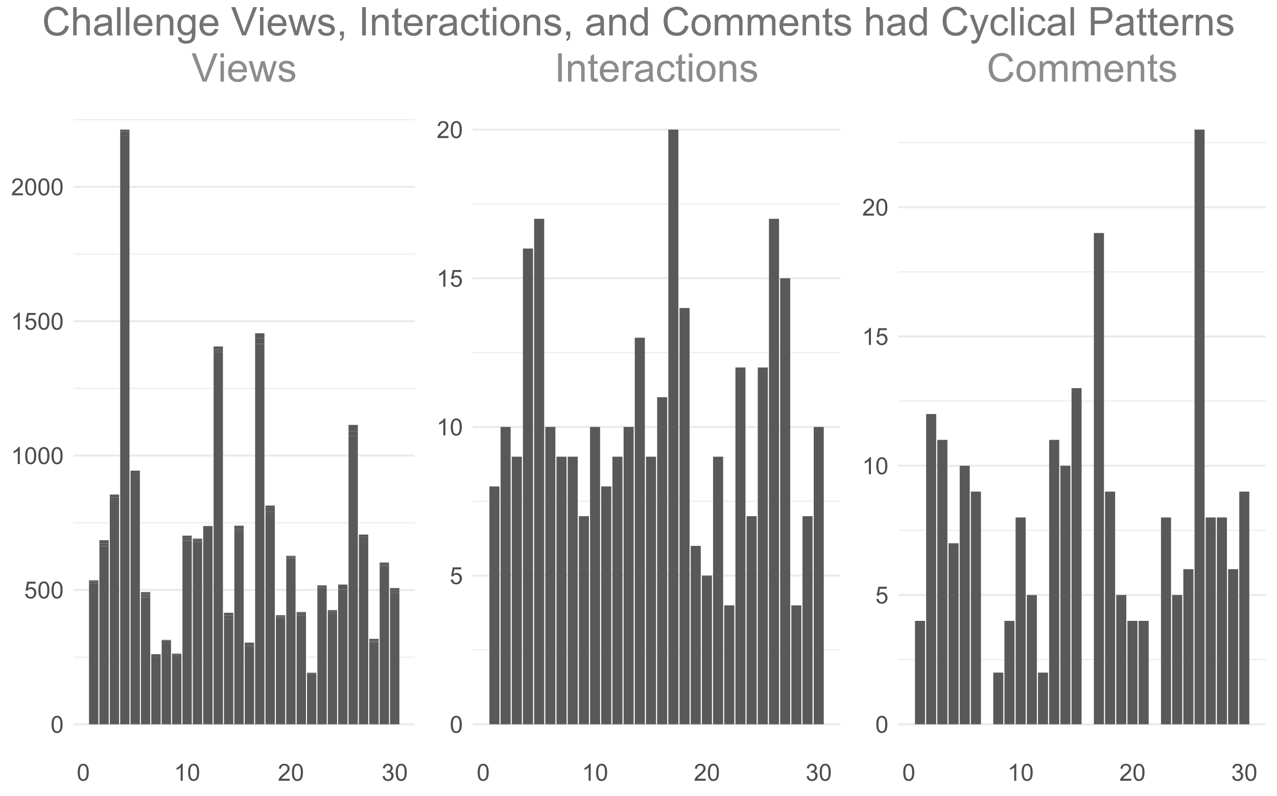
Notes:
column_VICCO

Slide 5
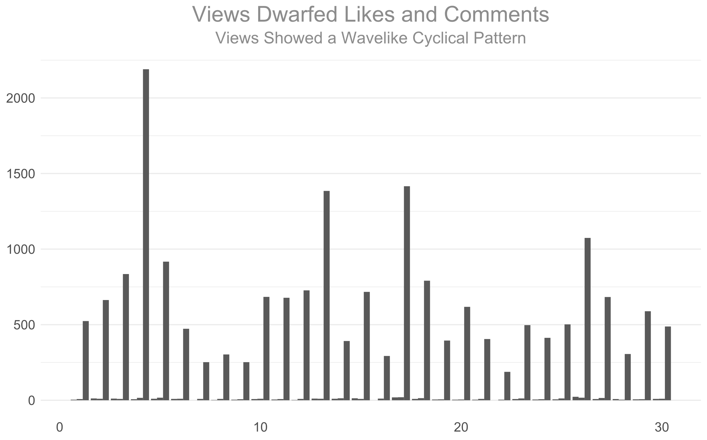
Notes:
vic_co1

Slide 6
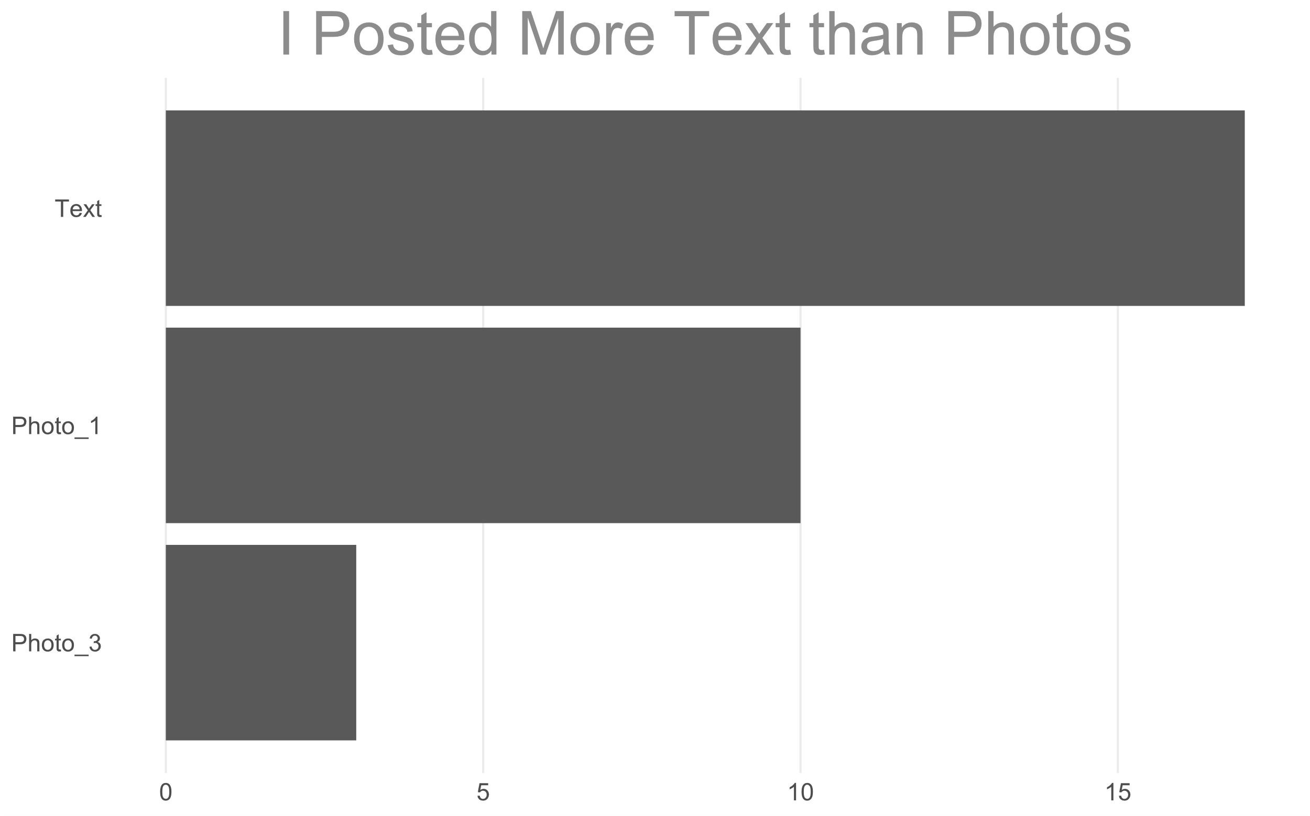
Post Types
Notes:
type4

Slide 7
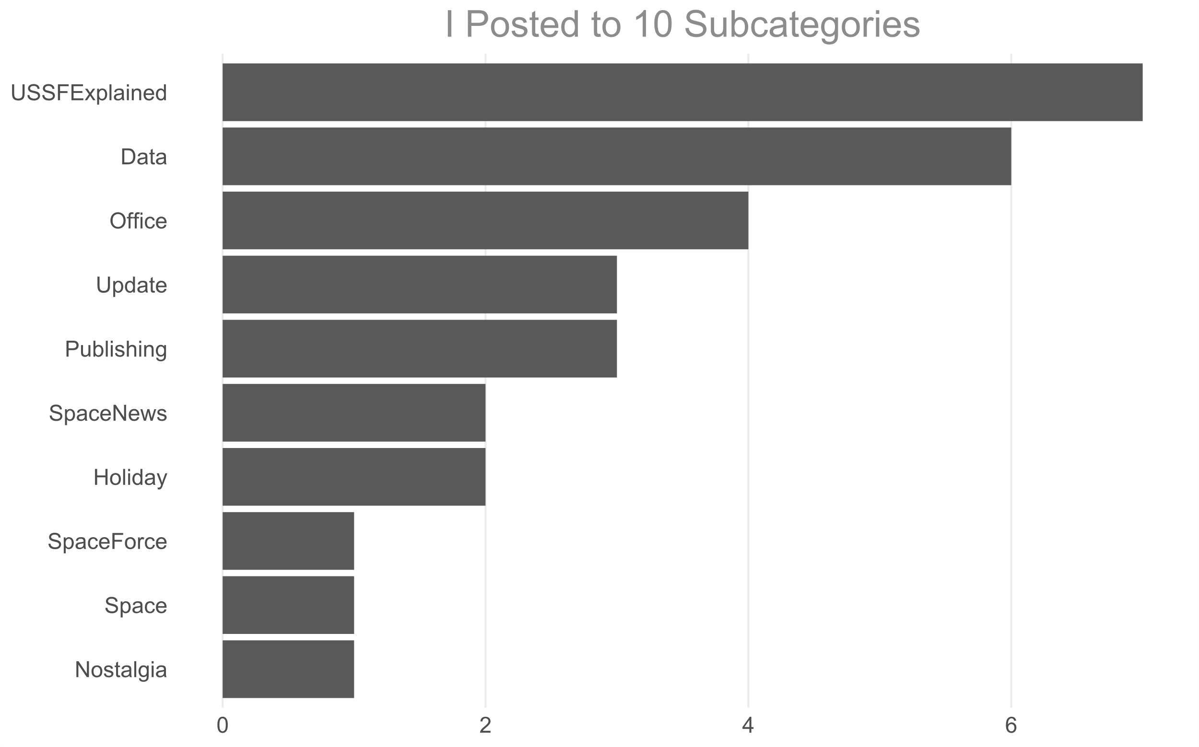
Category Post Counts
Notes:
cat4

Slide 8
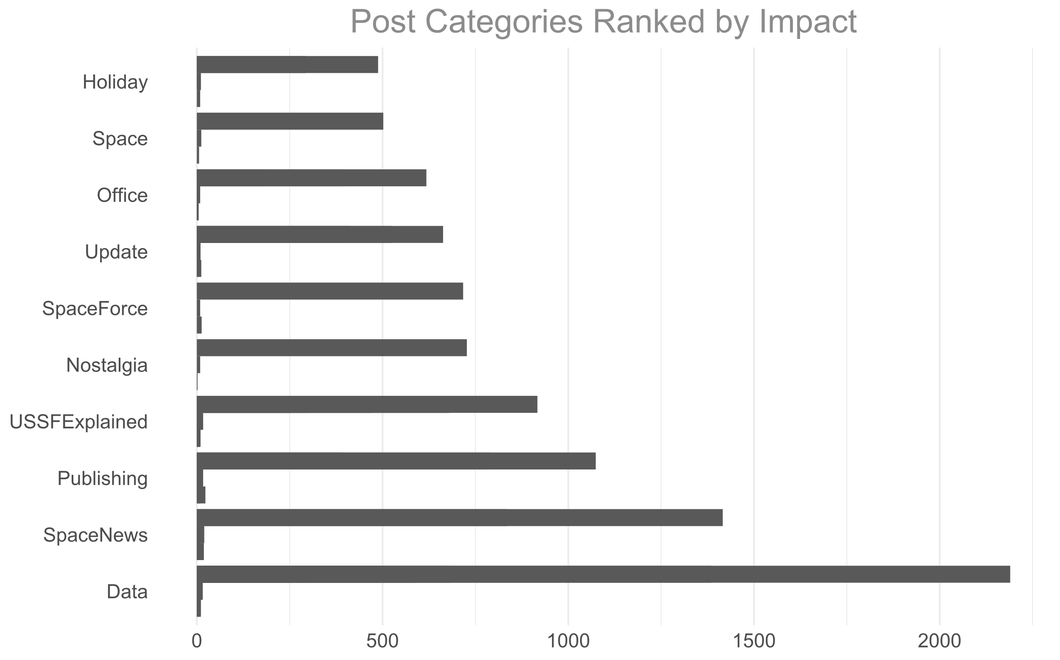
Data Posts Performed Best
Notes:
cat_co

Slide 9
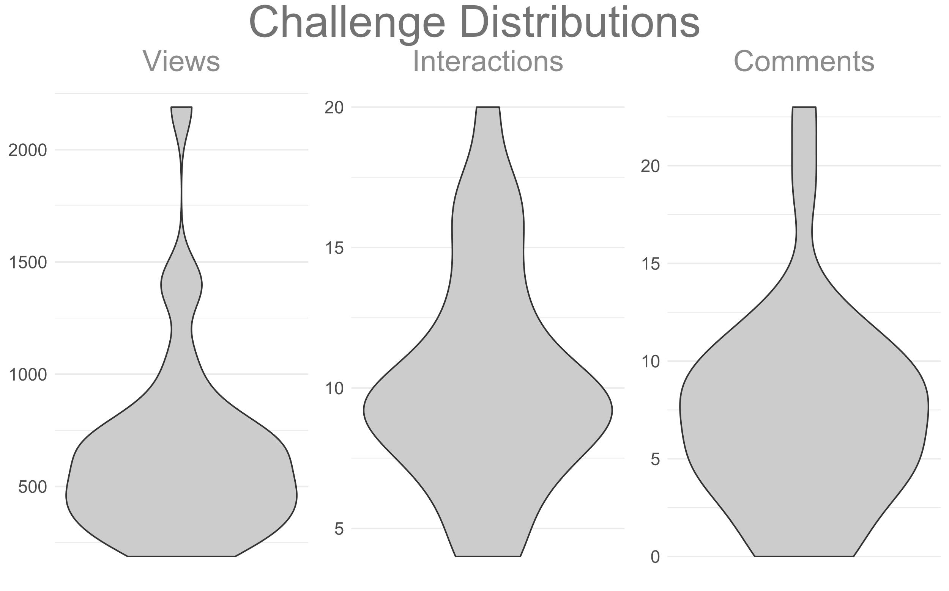
Probability Distribution of Metrics
Notes:
Violin_VICCOT

Slide 10
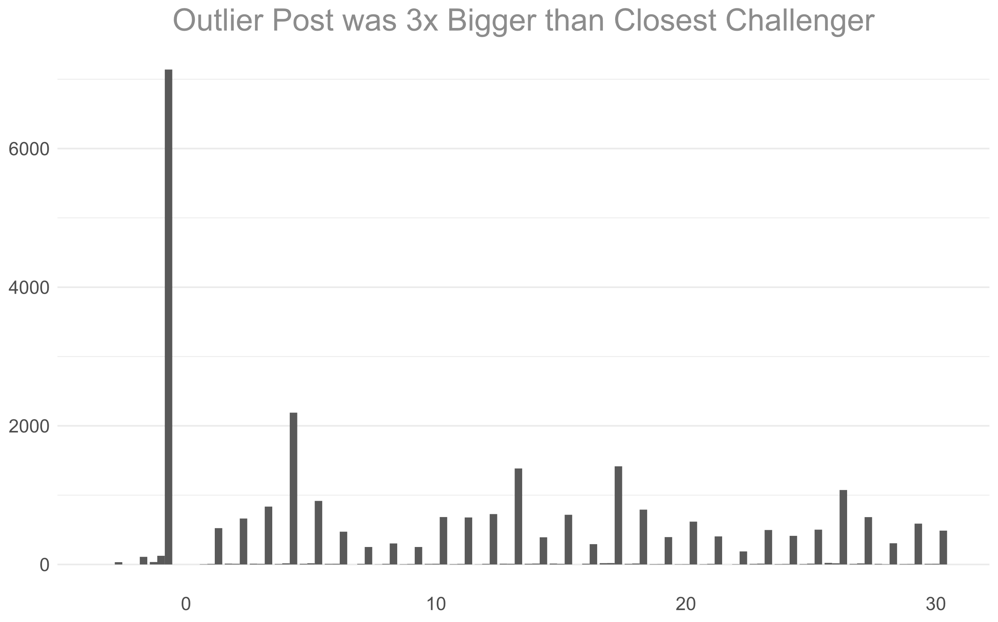
How Prior Posts Compared
Pre-Challenge Posts in Box
Notes:
vic1

